Slide 1

R Project
Presented by: Marc Arnaud Kambou

Slide 2

INTRODUCTION
Data presentation
From Kaggle: retail store transactions
3 different files merged together
Transactions from 2011 to 2014
23053 rows with 15 variables
Missing values: 17 rows
Subset dataset (2013, 2014) : 7727 rows and 11 variables ➔ Rdata

Slide 3
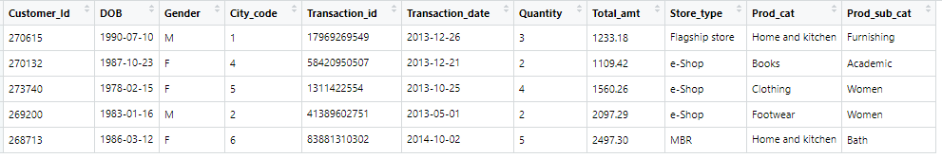
Dataset sample
sample = Rdata[sample(nrow(Rdata),5),]

Slide 4
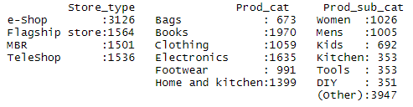
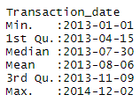

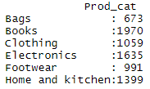
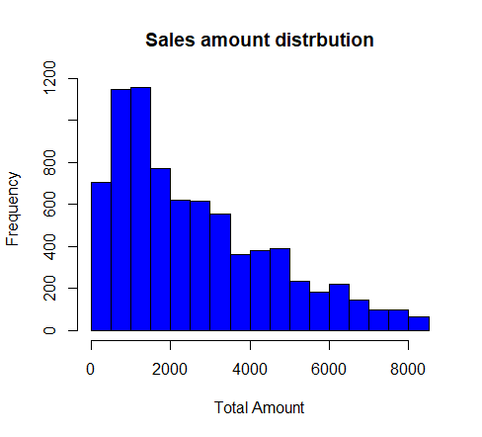
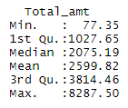
1) Basic analysis
summary(Rdata)
layout(matrix(c(1,1), nrow = 1, ncol = 1, byrow = TRUE))
hist(Rdata$Total_amt, xlab = "Total Amount", main = "Sales amount distrbution", col = "blue")
Positively skewed

Slide 5



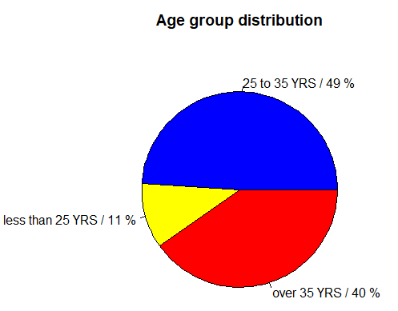
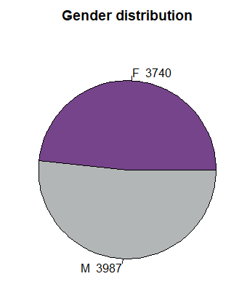
2) Relation between gender, sales and age

Slide 6
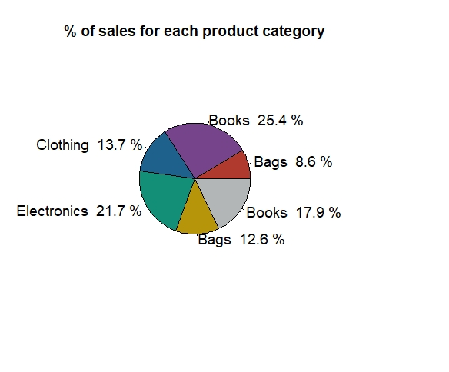
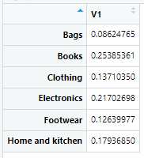
3) Which Product category is more popular?
table_prodcat_sum = as.matrix(prop.table(by(Rdata$Total_amt, Rdata$Prod_cat, sum)))
layout(matrix(1), 1, 1)
pie(table_prodcat_sum, labels =
paste(names(table_prodcat_sum[1:4,]), "", round(table_prodcat_sum[,1]*100, digits = 1), '%'),
main = "% of sales for each product category", cex = 1.2,
col = c("#b03a2e", "#76448a", "#1f618d", "#148f77", "#b7950b", "#b3b6b7"))

Slide 7
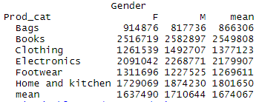
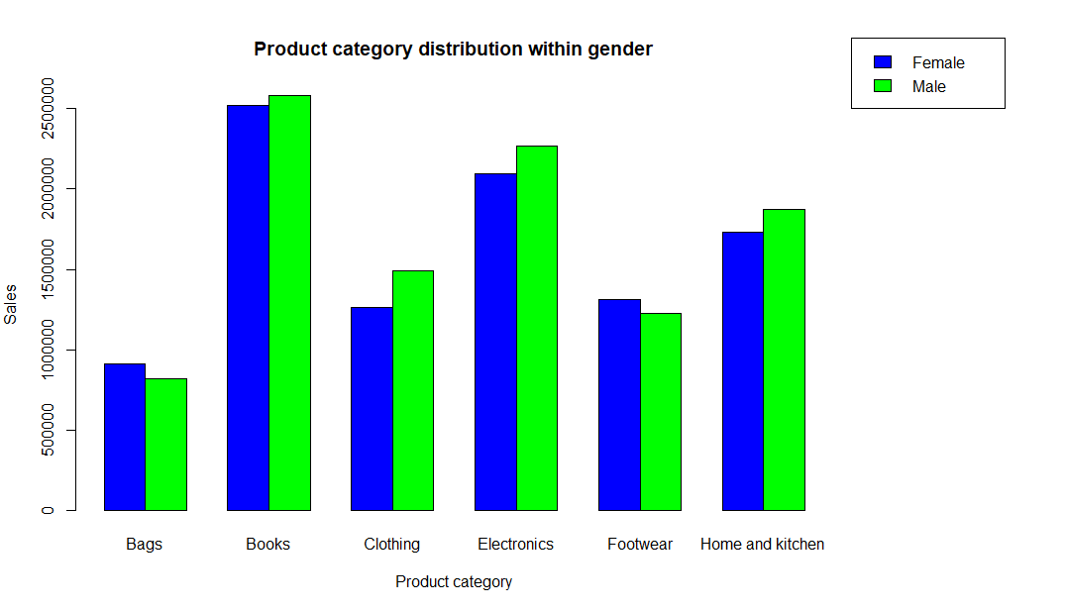
4) Product distribution within gender

Slide 8

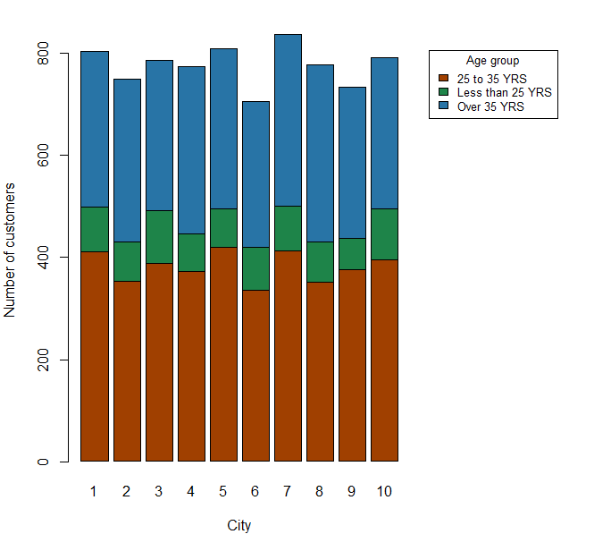
5) Age group distribution per city
table_agegrp_city =
table(age_group, City_code)

Slide 9
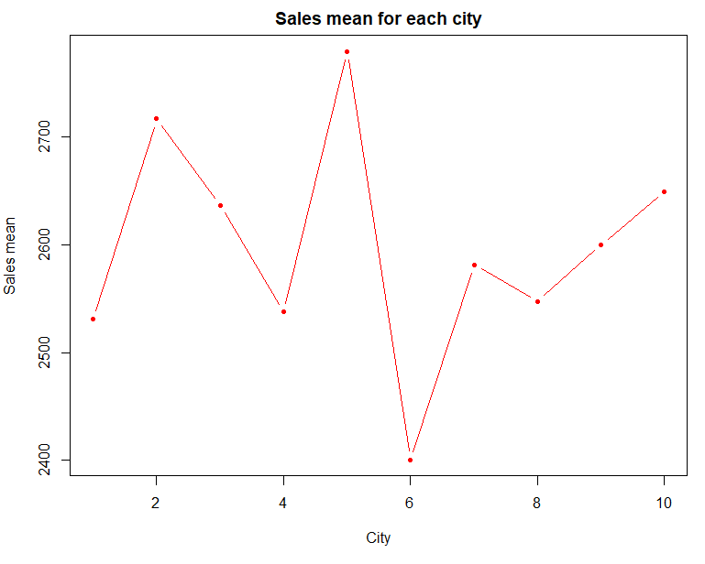
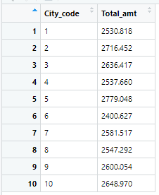
6) Sales mean per city

Slide 10
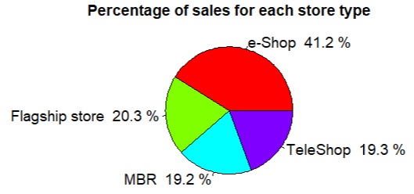
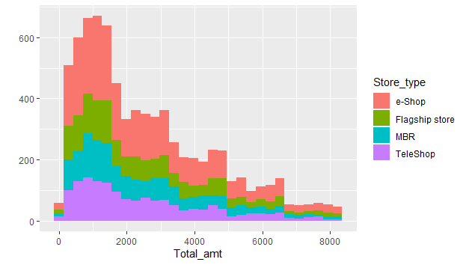
7) Sales amount per store type

Slide 11
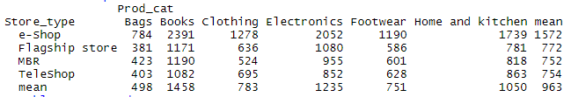
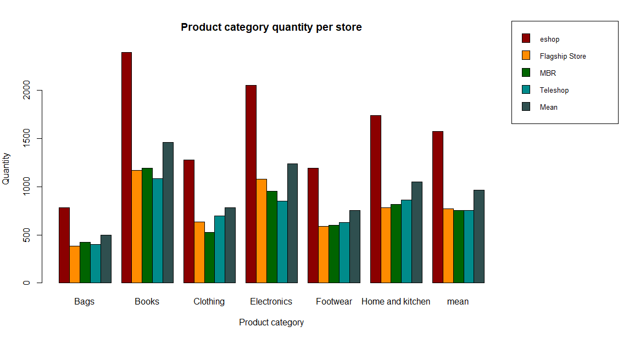
8) Relation between store type and product category

Slide 12

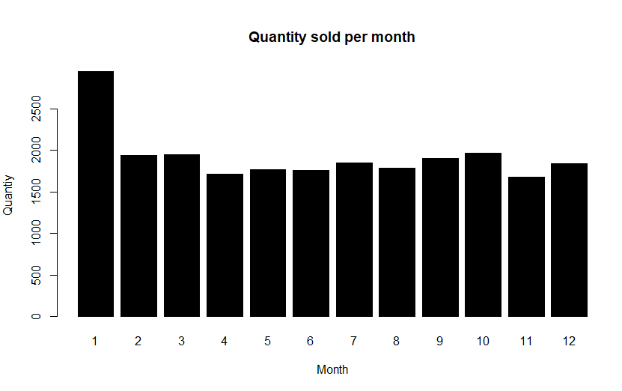
9) Quantity sold per month

Slide 13
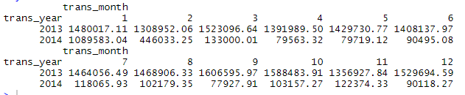
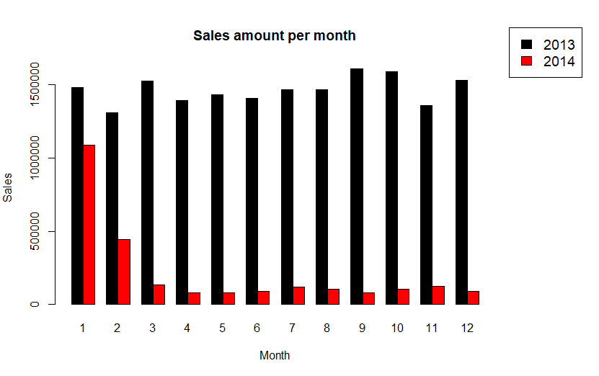
10) Total sales per month for each year

Slide 14
THANK YOU

